Slide 1
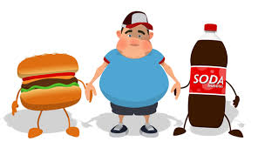
Obesity.

Slide 2
What? Obesity is defined as having too much body fat, and is likely to cause serious health problems (NHS, 2014). The body mass index is commonly used and measures height 2 weight ratio. However criticism of the BMI, suggests that the method does not distinguish between muscle and fat (BBC, 2013).

Slide 3
Why? Inactive lifestyle – spend a lot of time near TV, computer, doing work, homework etc. (NHLBI. GOV 2012). Study by Jeffrey (1997) found that TV watching and fast food eating were positively correlated. Also they found that people with lower income were highly affected by this. Environment: some researchers suggest that it is because lack of sidewalks, trails parks. Gyms are not affordable. Work schedules - people suggesting they don’t have a time for exercise. Oversized food portions, especially in America – some of them could feed 2/3 people but are given to one. Lack of access to healthy food options - suggest that there are people living in areas where there is not healthy food options near by. Food advertising – targeting children with high calorie food and snacks. (NHLBI. GOV, 2012). Genes: Several twin studies have shown that there is a link between genetics an obesity and there are possibility o inherit obesity from the parents ( NHLBI. GOV, 2012). Cline et.al. (2015) found that genetic factors have a high impact on fast food consumption and obesity. Health Conditions: sometimes hormone levels, such as underactive thyroid can also increase weight and create obesity (NHLBI. GOV, 2012). Medicine: according to NHLBI certain medicine can also impact the levels of obesity.

Slide 4
Emotional Factors: there have been studies suggesting that some people when they are bored, angry stressed have a tendency to eat more which also are possible carouse of overweight (NHLBI. Gov, 2012).
Lack of sleep: has also been found one of the reasons why people might get obese. For example, one study of teenagers showed that with each hour of sleep lost, the odds of becoming obese went up. Lack of sleep increases the risk of obesity in other age groups as well.
People who sleep fewer hours also seem to prefer eating foods that are higher in calories and carbohydrates, which can lead to overeating, weight gain, and obesity (NHLBI. Gov, 2012).
Pregnancy: after giving birth, some women have an overweigh it find hard to loose it. This may lead to overweight or obesity, especially after a few pregnancies.

Slide 5
How? Some of the ideas: Easy access to takeaway. Exposure to fast food outlets creates increased fast food consumption. (NHS, 2014) Research by Courtemanche et.al. (2015) found that obesity is associated with economics as wel. They suggested that discount factor highly impacts the obesity because of the are more likey to by unhelthy options. They also looked at impatiance and link to BMI and interestibgly found that impatient peoples are also morelikely to buy unhalthy options instead of helthy, increasing obesity. Study by Drewnowski et.al. (2014) found that people from lower socioeconomic class tend to prefer cheaper, unhealthier food options comparing to the people with higher income. This study suggested that people who have higher income and higher education obesity was lower. Interestingly they found that distance to nearest supermarket was not influential on obesity, which sometimes is a stereotype. Research by Sengupta et.al. (2015) found that in India obesity in female population is much higher in urban areas comparing to the rural areas. Suggesting that it might be because lower energy deficiency. Study by Harrington (2008) found that high sugary beverages and high level of sugars in foods are one of the high reasons for adolescent obesity and creates higher risk of insulin and diabetes.

Slide 6
Who? Internationally obesity is most common in the USA. Statistics in USA suggests that 35.9% considered obese. The least obese are Japan at 3.5%. England rates quite highly at 24.8 %. (OECD Health Data 2012). Studies suggest that obesity is most common in low oncome households. Wages were inversely related to BMI and obesity. (Truong and Sturm, 2005). Kim and Leigh 2010).

Slide 7
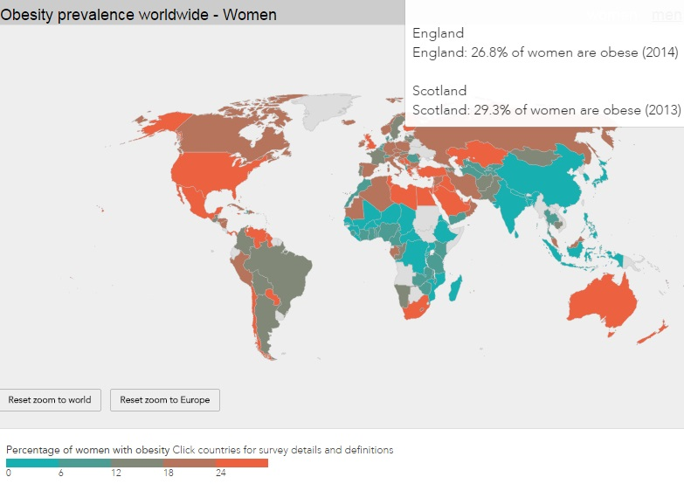
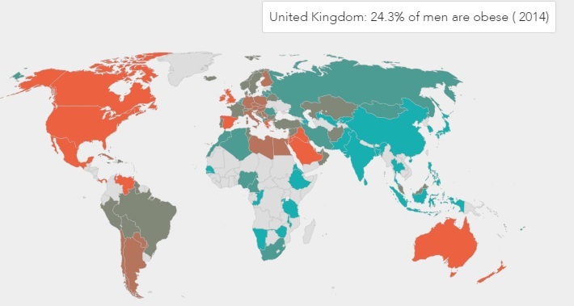
Where?

Slide 8
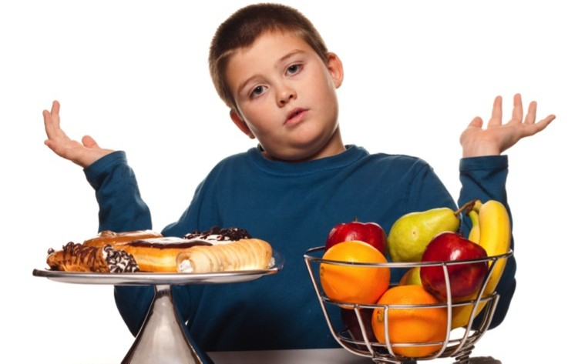
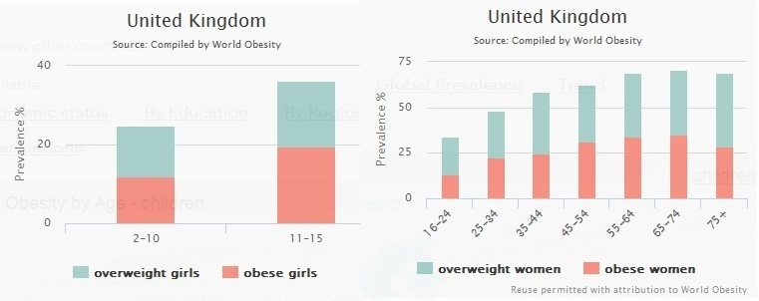
When? Obesity most commonly begins between the ages 5 and 6, or during adolescence (aacap.org, 2011) One out of 6 children ages 2 – 19 are obese (Ogden, et. al. 2012).

Slide 9
Questions?

